Slide 1


Conditional Statements

Slide 2
Flow of Control in a Program
Each program you write will typically have:
Sequence | Things that will be done in a particular order
Selection | Things that will be done conditionally
Iteration | Things that will be done repetitively

Slide 3
Flow of Control in a Program
Each program you write will typically have:
Sequence | Things that will be done in a particular order
Selection | Things that will be done conditionally
Iteration | Things that will be done repetitively

Slide 4
Boolean Condition

Slide 5
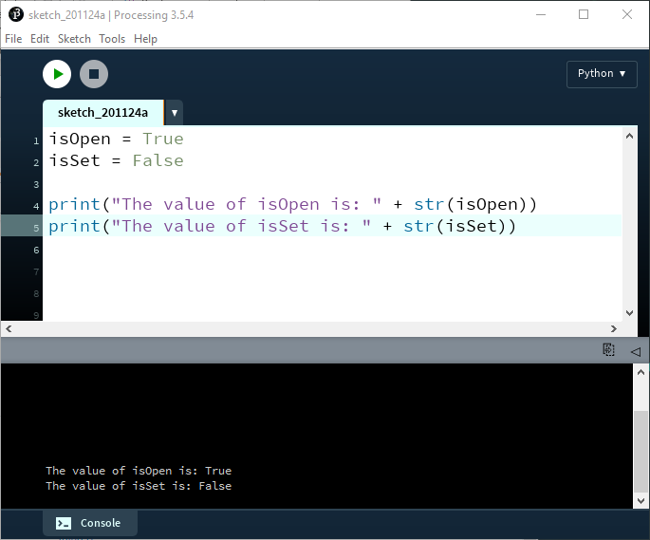
Data Types - Boolean
Do you remember our Boolean data type? It holds a value of either True or False.
Notes:
isOpen = True
isSet = False
print("The value of isOpen is: " + str(isOpen))
print("The value of isSet is: " + str(isSet))

Slide 6
Boolean Condition
A Boolean condition is an expression that evaluates to either True or False e.g.
mouseX < 50
A conditional statement evaluates a Boolean condition and its result will determine which section of the code is executed.

Slide 7
Conditional Statements
The if statement

Slide 8
if statement syntax
if perform some boolean test:
Do these statement(s) if the test is true

Slide 9
if statement syntax
: starts an indented suite of statements
‘if’ keyword
if perform some boolean test:
Do these statement(s) if the test is true

Slide 10
if statement syntax
boolean condition to be tested
if perform some boolean test:
Do these statement(s) if the test is true

Slide 11
if statement syntax
actions if condition is true.
if perform some boolean test:
Do these statement(s) if the test is true
NOTE:
Python relies on indentation to define scope in the code.
Indentation is a whitespace at the beginning of the line.
We saw this earlier when writing functions.
Notes:
The programmer can choose how many white spaces they would like to include for their indentation, but they need to be consistent, otherwise you may get a syntax error.

Slide 12
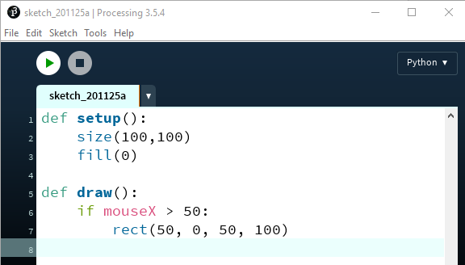

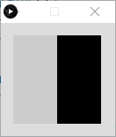
if statement example 1
When the program starts…
When mouseX > 50
Notes:
def setup():
size(100,100)
fill(0)
def draw():
if mouseX > 50:
rect(50, 0, 50, 100)

Slide 13
Relational Operators
Used for comparing values

Slide 14
Relational Operators
Operator | Syntax | Returns true if…
> | x > y | x is greater than y
>= | x >= y | x is greater than or equal to y
< | x < y | x is less than y
<= | x <= y | x is less than or equal to y
== | x == y | x and y are equal
!= | x != y | x and y are not equal
= is an assignment operator and doesn’t test for equality.
== is used to test for equality.

Slide 15
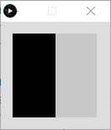
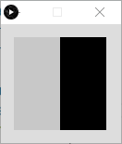
if statement example 2
If the x-coordinate of the mouse pointer is on the:
…left half of the display window, draw a rectangle on the left hand side.
…right half of the display window, draw a rectangle on the right hand side.

Slide 16
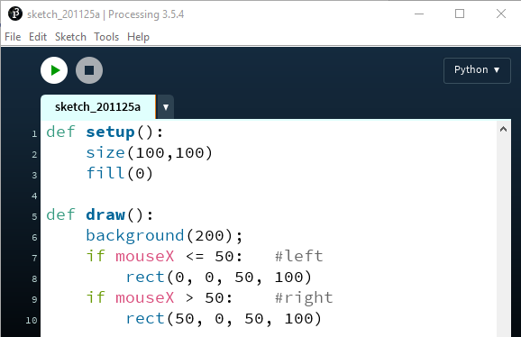
if statement example 2
When mouseX <= 50
When mouseX > 50
Notes:
def setup():
size(100,100)
fill(0)
def draw():
background(200);
if mouseX <= 50: #left
rect(0, 0, 50, 100)
if mouseX > 50: #right
rect(50, 0, 50, 100)

Slide 17
Conditional Statements
if-else syntax

Slide 18
if-else syntax
boolean condition to be tested
: starts an indented suite of statements
‘if’ keyword
if perform some boolean test:
Do these statement(s) if the test is true
else:
Do these statement(s) if the test is false

Slide 19
if-else syntax
actions if condition is true.
if perform some boolean test:
Do these statement(s) if the test is true
else:
Do these statement(s) if the test is false
if perform some boolean test:
Do these statement(s) if the test is true

Slide 20
if-else syntax
if perform some boolean test:
Do these statement(s) if the test is true
else:
Do these statement(s) if the test is false
‘else’ keyword
: starts an indented suite of statements

Slide 21
if-else syntax
if perform some boolean test:
Do these statement(s) if the test is true
else:
Do these statement(s) if the test is false
if perform some boolean test:
Do these statement(s) if the test is true
actions if condition is false.

Slide 22
if statement example 2
Returning to our previous example…we used two if statements
When mouseX <= 50
When mouseX > 50
Notes:
def setup():
size(100,100)
fill(0)
def draw():
background(200);
if mouseX <= 50: #left
rect(0, 0, 50, 100)
if mouseX > 50: #right
rect(50, 0, 50, 100)

Slide 23

if statement example 2
Now we are using one if with an else clause.
When mouseX <= 50
otherwise
Notes:
def setup():
size(100,100)
fill(0)
def draw():
background(200);
if mouseX <= 50: #left
rect(0, 0, 50, 100)
else: #right
rect(50, 0, 50, 100)

Slide 24
Conditional Statements
if-elif-else syntax

Slide 25
if-elif-else syntax
if condition1…perform some boolean test:
Do these statement(s) if the test is true
elif condition2…perform some boolean test:
Do these statements if condition1 gave a
false result and condition2 gave a true
result
else:
Do these statements if both condition1 and
condition2 gave a false result
Notes:
You can have as many occurrences of “elif” as you wish

Slide 26
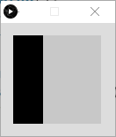
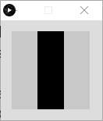
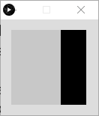
if statement example 3
If the x-coordinate of the mouse pointer is on the:
left third of the display window, draw a rectangle on the left third of the window.
middle third of the display window, draw a rectangle on the middle third of the window.
right third of the display window, draw a rectangle on the right third of the window.

Slide 27
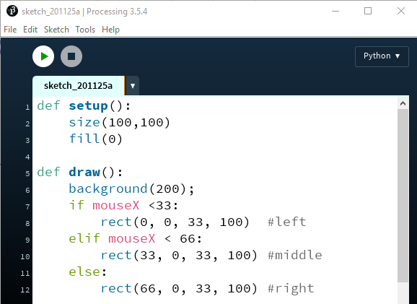
if statement example 3

Slide 28
Logical Operators

Slide 29
Logical operators
Logic operators operate on boolean values.
They produce a new boolean value as a result.
The ones that we will use, so far, are:
and
or
not

Slide 30
Logical operators - AND
a and b
a | b | a and b
1 | 1 | 1
0 | 1 | 0
1 | 0 | 0
0 | 0 | 0
Evaluates to true if both a and b are true.
It is false in all other cases.

Slide 31
Logical operators - OR
a or b
a | b | a or b
0 | 0 | 0
0 | 1 | 1
1 | 0 | 1
1 | 1 | 1
It is false if both are false.
Evaluates to true if either a and b, or both are true.

Slide 32
Logical operators - NOT
not a
Evaluates to true if a is false.
a | not a
0 | 1
1 | 0
Evaluates to false if a is true.

Slide 33
Logical operators - quiz
a = 5
b = 10
c = 7
What is the result of each of these boolean expressions:
Q1 (a > b) and (a < c)
Q2 (a < b) or (c < a)
Q3 not(b < a) and (c > b)

Slide 34
Logical operators - answers
Q1 (a > b) and (a < c)
A1 (5>10) is true. (5<7) is true. Overall answer is TRUE
a = 5
b = 10
c = 7
Q2 (a < b) or (c < a)
A2 (5 < 10) is true. As we are using OR, the overall answer is TRUE.
Q3 not(b < a) and (c > b)
A3 not(10 < 5) is true. (7 > 10) is false. Overall answer is FALSE.

Slide 35


if statement example 4
If the (x, y) coordinates of the mouse pointer are:
inside the rectangle coordinates, then fill the rectangle with white.
outside the rectangle coordinates, then fill the rectangle with black.

Slide 36
if statement example 4
The rectangle coordinates are (10, 20), width is 50 and height is 70.
(10,20)
(60,20)
(10,90)
(60,90)

Slide 37
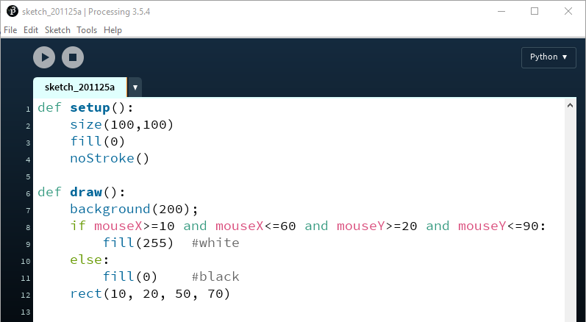
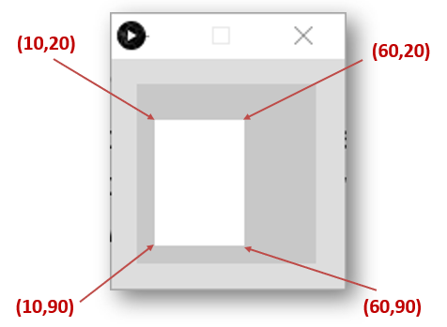
if statement example 4
Notes:
def setup():
size(100,100)
fill(0)
noStroke()
def draw():
background(200);
if mouseX>=10 and mouseX<=60 and mouseY>=20 and mouseY<=90:
fill(255) #white
else:
fill(0) #black
rect(10, 20, 50, 70)

Slide 38
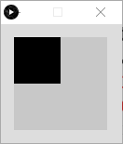
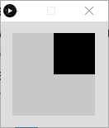
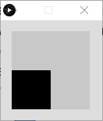
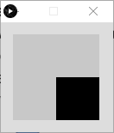
if statement example 5
If the (x, y) coordinates of the mouse pointer are in the:
upper-left quadrant of the display window, draw a black rectangle covering the upper-left quadrant of the window.
Repeat this approach for the following quadrants:
upper-right lower-left lower-right

Slide 39
if statement example 5
The display window is (100,100). The rectangle width is 50 and height is 50.
(0,0)
(50,0)
(50,50)
(0,50)

Slide 40
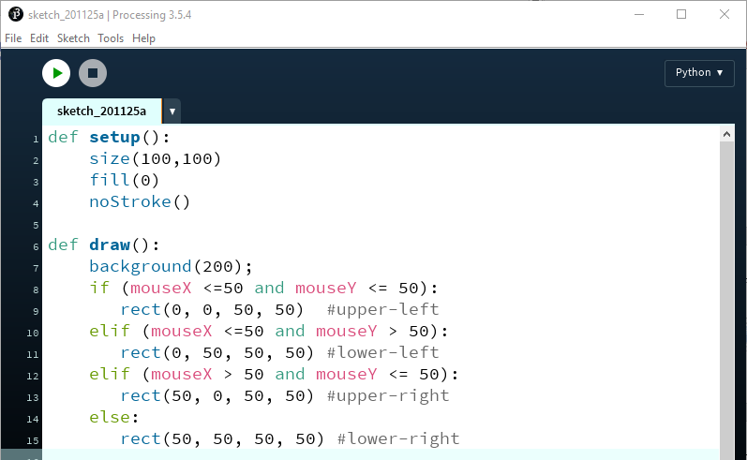
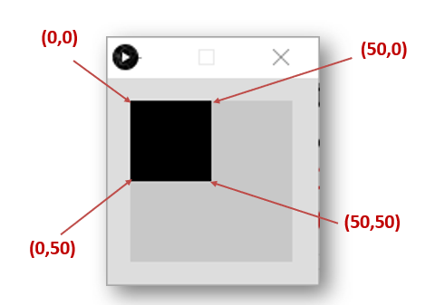
if statement example 5
Notes:
def setup():
size(100,100)
fill(0)
noStroke()
def draw():
background(200);
if (mouseX <=50 and mouseY <= 50):
rect(0, 0, 50, 50) #upper-left
elif (mouseX <=50 and mouseY > 50):
rect(0, 50, 50, 50) #lower-left
elif (mouseX > 50 and mouseY <= 50):
rect(50, 0, 50, 50) #upper-right
else:
rect(50, 50, 50, 50) #lower-right

Slide 41
Some Syntax Errors

Slide 42
Some Syntax Errors
We have four Boolean conditions on one line. If we wanted to display them over two lines…

Slide 43
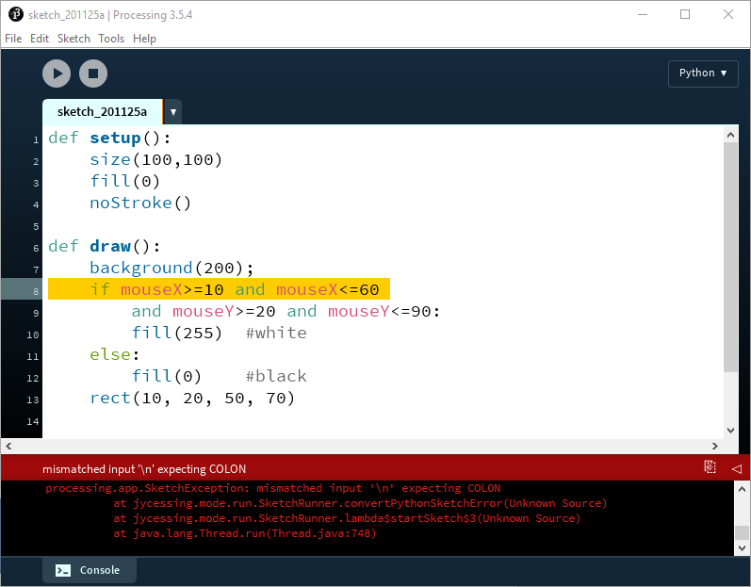
Some Syntax Errors
…we get a syntax error!

Slide 44
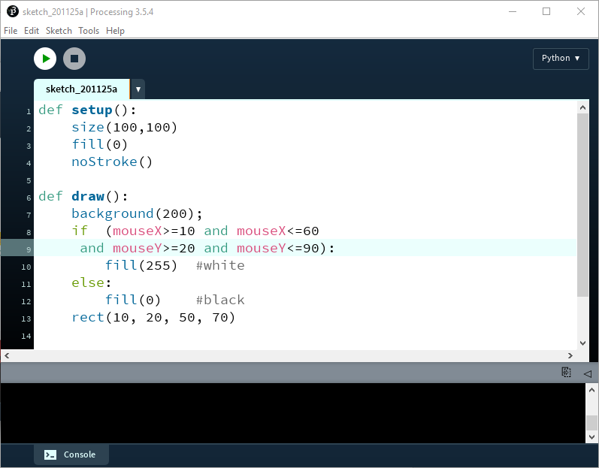
Some Syntax Errors
To fix it, add parenthesis around the full Boolean condition i.e. the ()

Slide 45
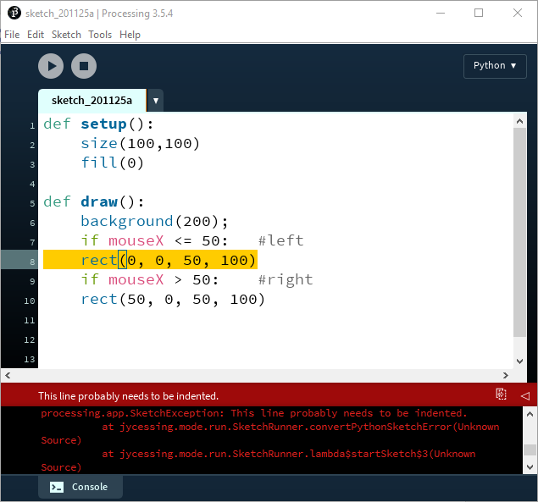
Some Syntax Errors
We have not indented the code under both of our if statements.
Indenting code is the only way that Python knows what code belongs to the if statement.

Slide 46
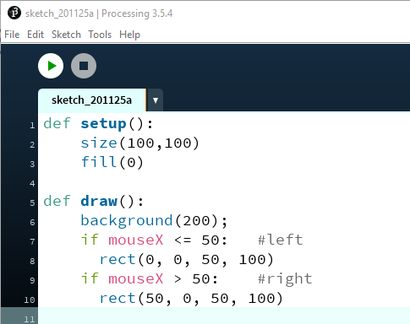
Some Syntax Errors
Correct indentation. Programmer can choose how many spaces to indent by.

Slide 47
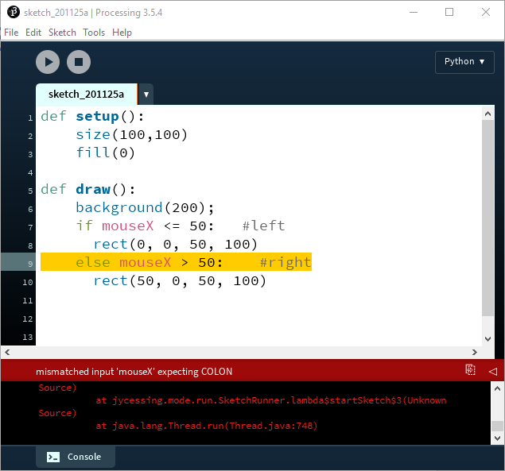
Some Syntax Errors
We have included a Boolean condition with our else. An else doesn’t have a Boolean condition….an elif has.

Slide 48
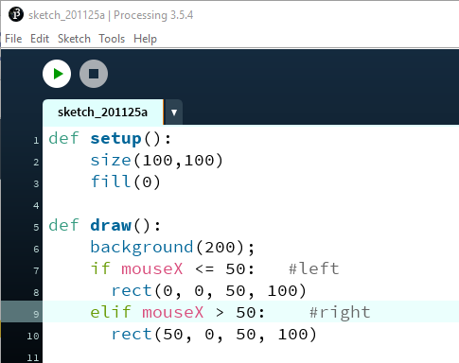
Some Syntax Errors
We have fixed the error by changing the else to elif here.

Slide 49

Some Syntax Errors
Our elif doesn’t have a matching if at the same indentation level.

Slide 50
Some Syntax Errors
We moved the elif to have the same number of whitespaces as the if above it.

Slide 51
Thank You!

Slide 52
References
Some of the examples in this slide deck are from the book:
Reas, C. & Fry, B. (2014) Processing – A Programming Handbook for Visual Designers and Artists, 2nd Edition, MIT Press, London.

